Slide 1
Twitter data analysis
Group 3
David Riemer(202332590)
Olivia Saukonoja

Slide 2
Table of contents
Purpose of our project
Methodology
Preprocessing of the data
Creating and applying the models
Evaluation
Comparison and Discussion

Slide 3
Purpose of project
Tweet Data
Tweet Data
Kaggle Competition | Twitter sentiment analysis – Determine emotional coloring of tweets
Goal | Find hidden relationships between tweets
Data format | CSV
Num of Data Columns | 2
Using Model | Word2Vec Singular Vector Decomposition K-means A-priori Logistic Regression
Performance | Accuracy (prediction only)
Pre-process Data
Pre-process Data
Word2Vec, SVD
Logistic Regression Classifier
Logistic Regression Classifier
Clustering
Apply Model
A-priori
Compare the performance
Find relationship in the data

Slide 4
Methodology

Slide 5
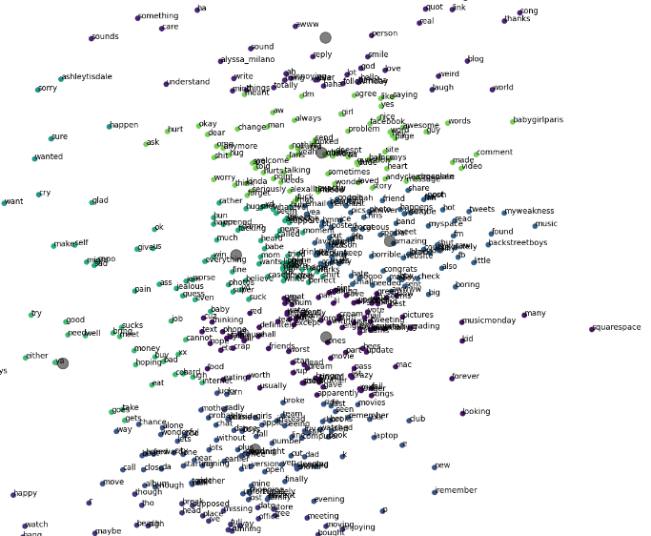
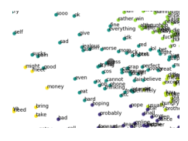
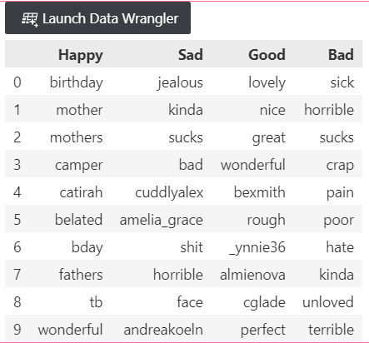
Data Preprocessing
Run our algorithms on the data
Results and Conclusion
Choose Kaggle Data
Twitter sentiment analysis
Dataset includes 100000 unique tweets
Data Clustering
Evaluation of the models
Data Preprocessing
Tokenize the words
Remove stop words
Hash the words to numerical values
Compare Importance of words
Models Used
Word2vec
SVD
K-means
A-priori
Logistic Regression
Set Database

Slide 6
preprocessing

Slide 7
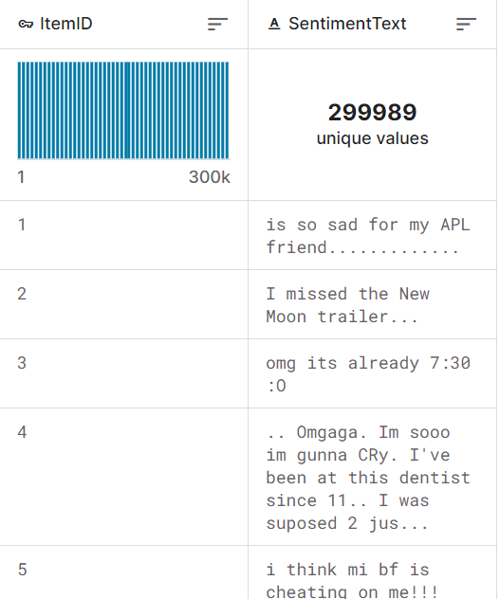
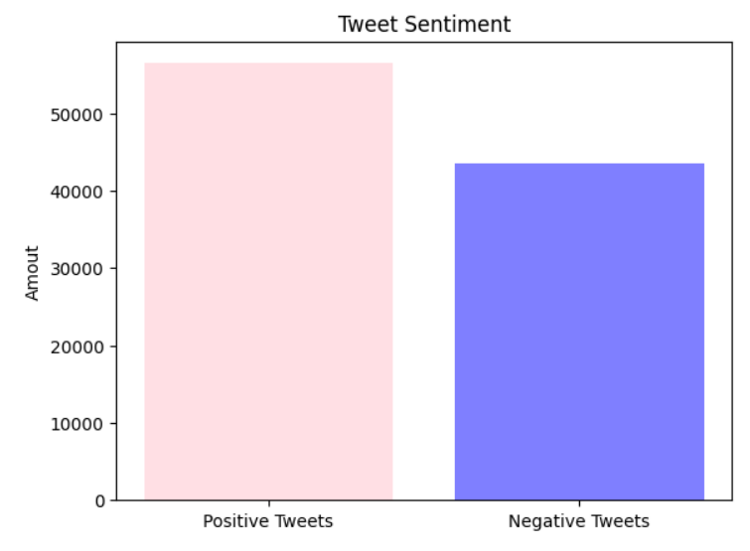
Data information

Slide 8
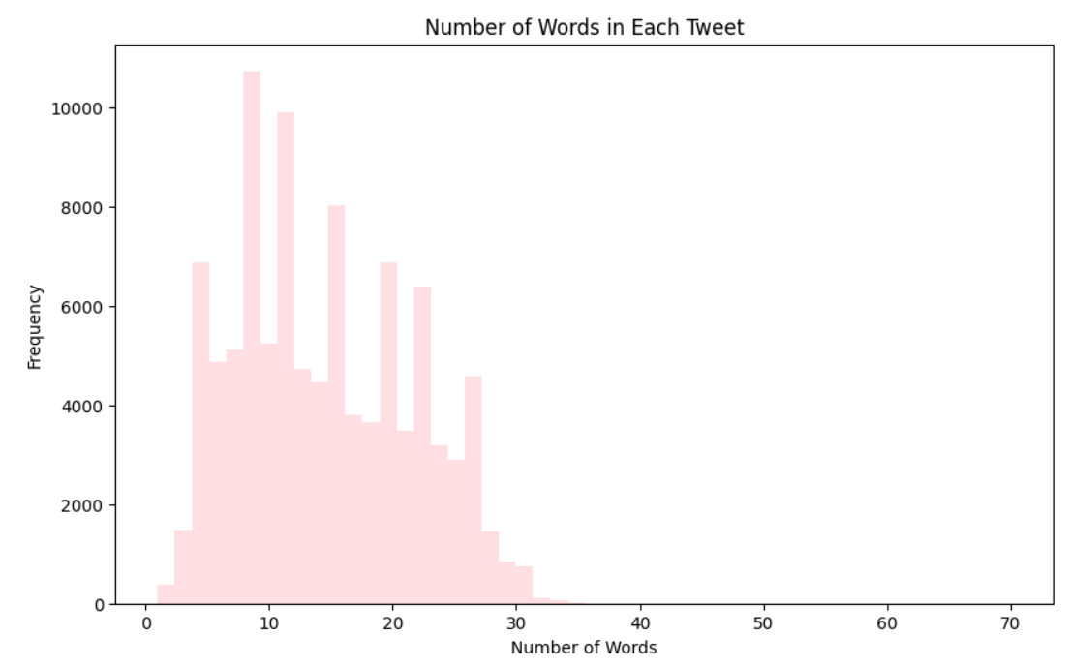
Basic Visualization
The longest tweet included 70 words, the shortest only 1
Average number of words: 15

Slide 9
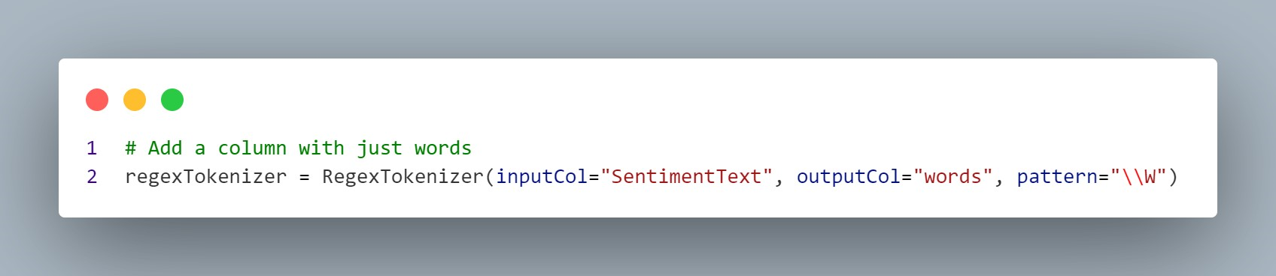
Tokenizing the words

Slide 10
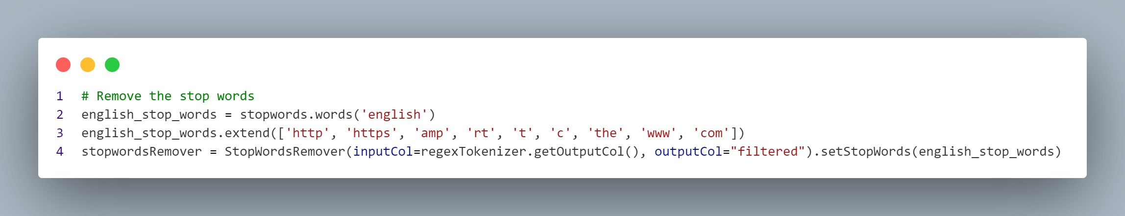
Removing stopwords

Slide 11
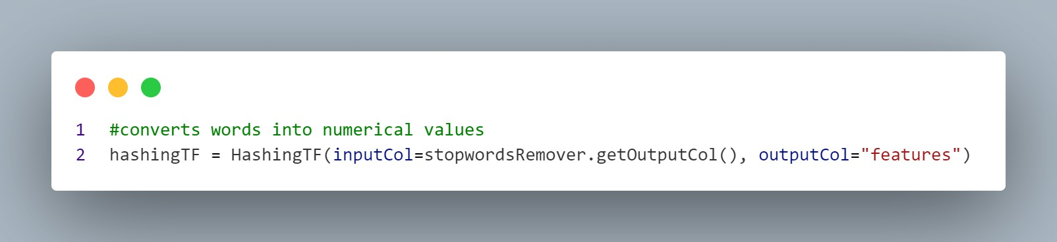
Hashing the words to their numerical values

Slide 12
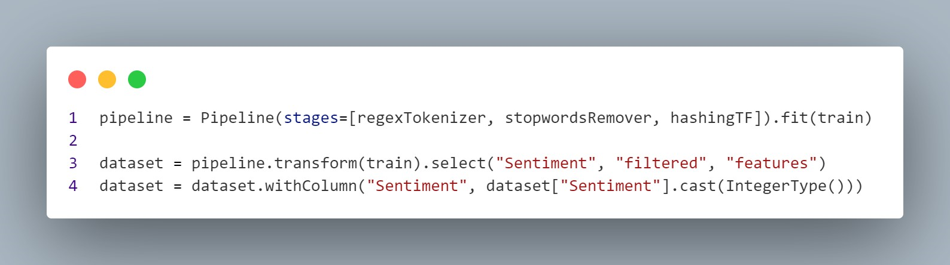
Run the pipeline and create the dataset

Slide 13
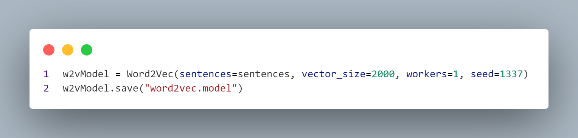
Creating the word2vec model

Slide 14
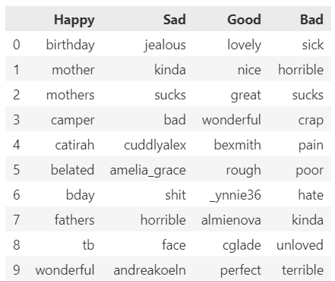
Getting the results from word2vec

Slide 15
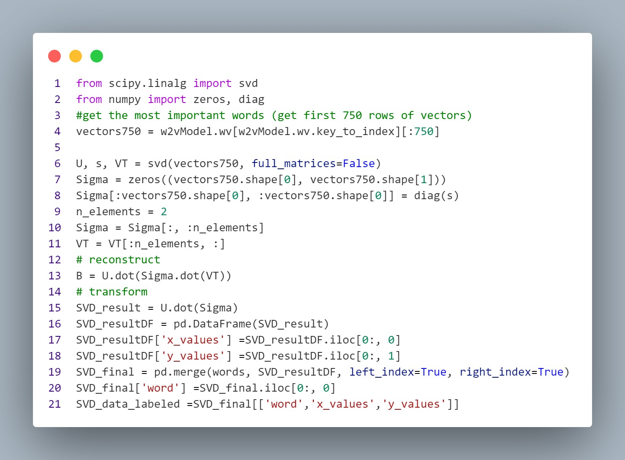
Reducing the dimensions using SVD

Slide 16
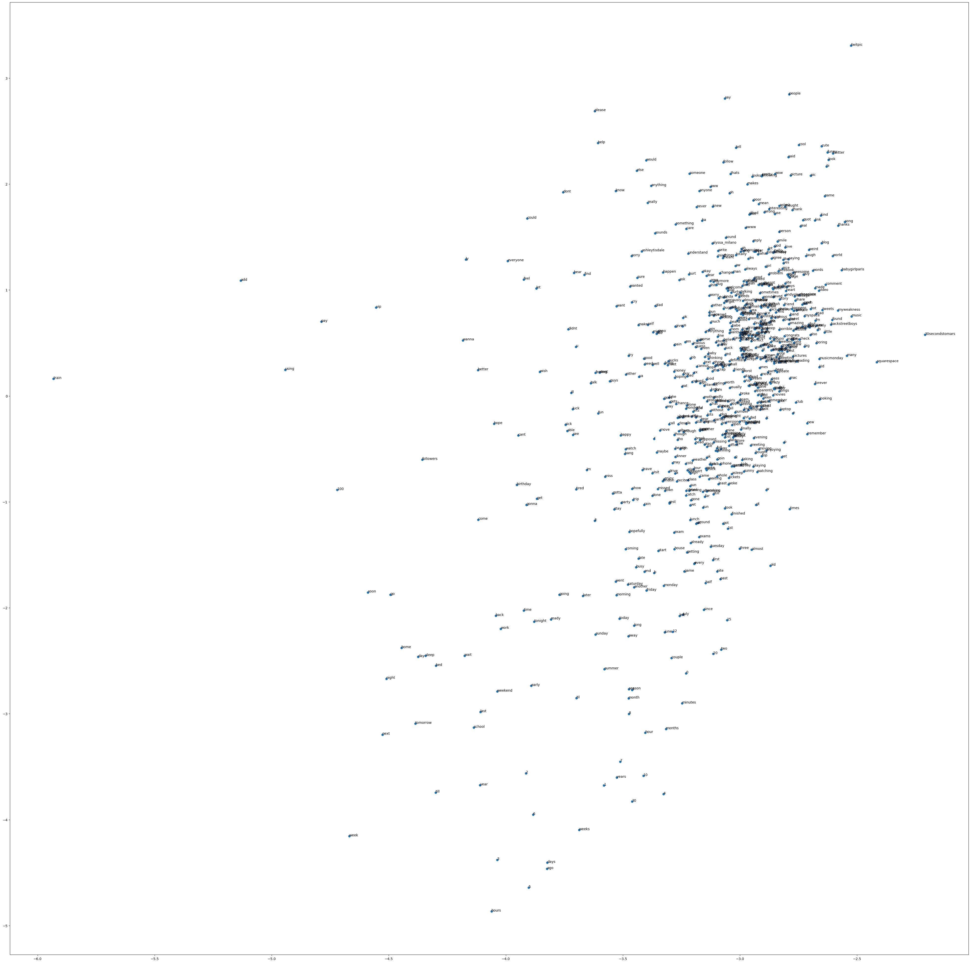
Plotting the words

Slide 17
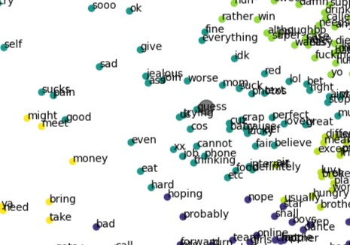
Cluster in the graph after k-means
We can see that words which express similar emotions are clustered together

Slide 18
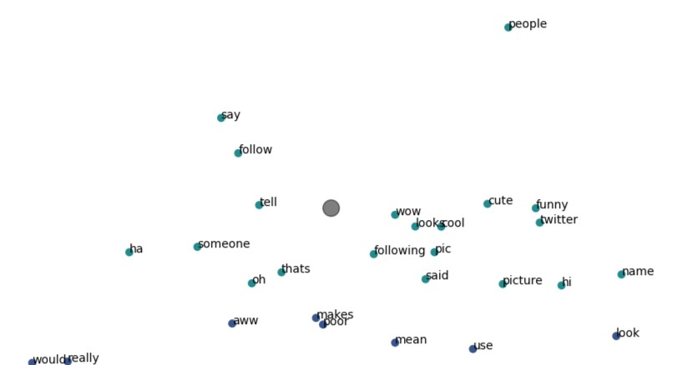
Cluster in the graph after k-means
We can see that words which express similar emotions are clustered together

Slide 19
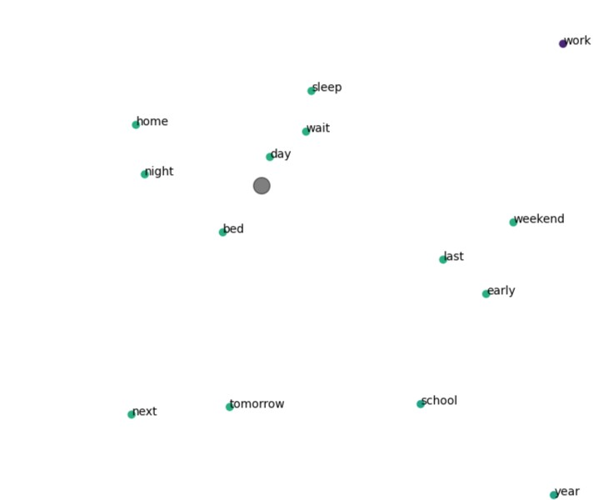
Cluster in the graph after k-means
We can see that words which express similar emotions are clustered together

Slide 20
A-priori

Slide 21
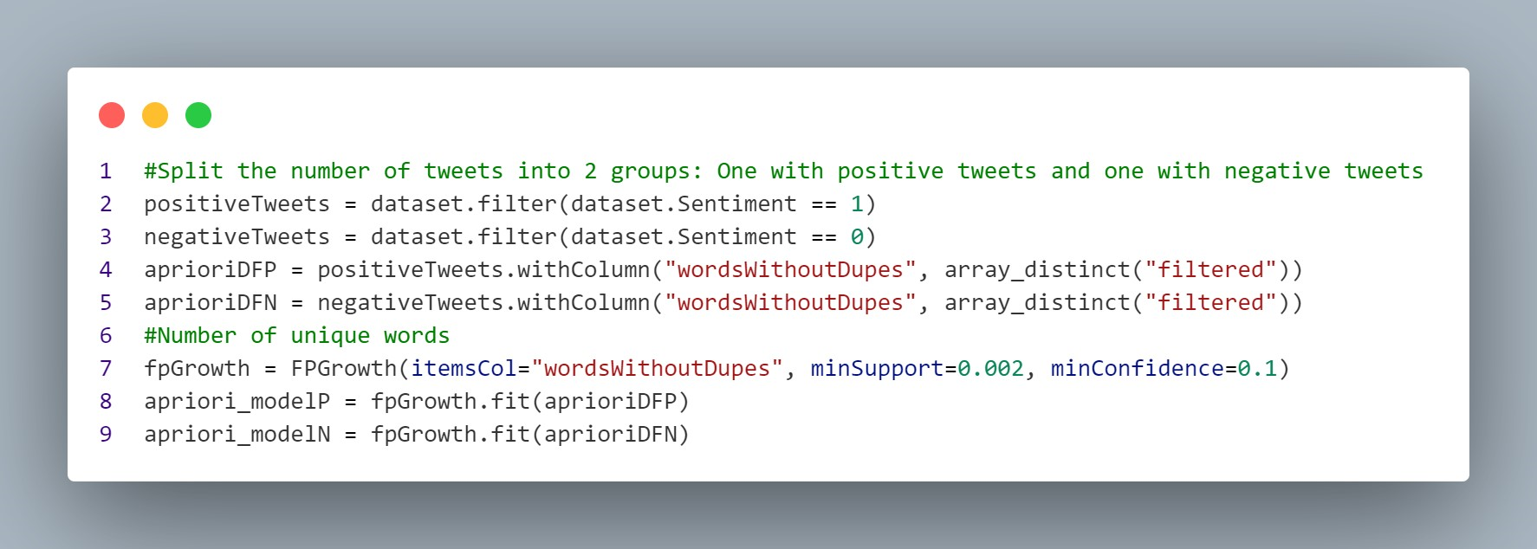
Splitting the data into only negative and positive sets

Slide 22
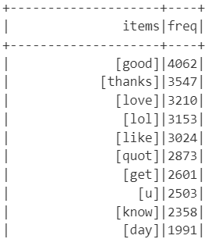
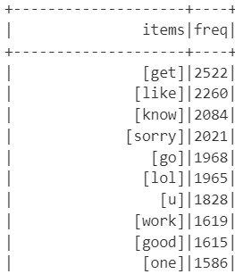
Most used words in
Positive Tweets
Negative Tweets
[morning, good]
[could, wish]

Slide 23
Building and applying a logistic regression model

Slide 24
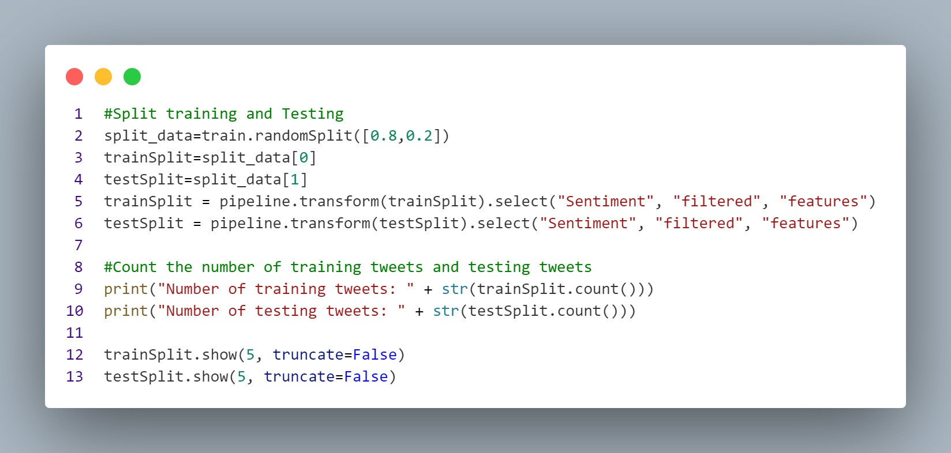
Creating the model
We decided on a 80/20 split of the data

Slide 25
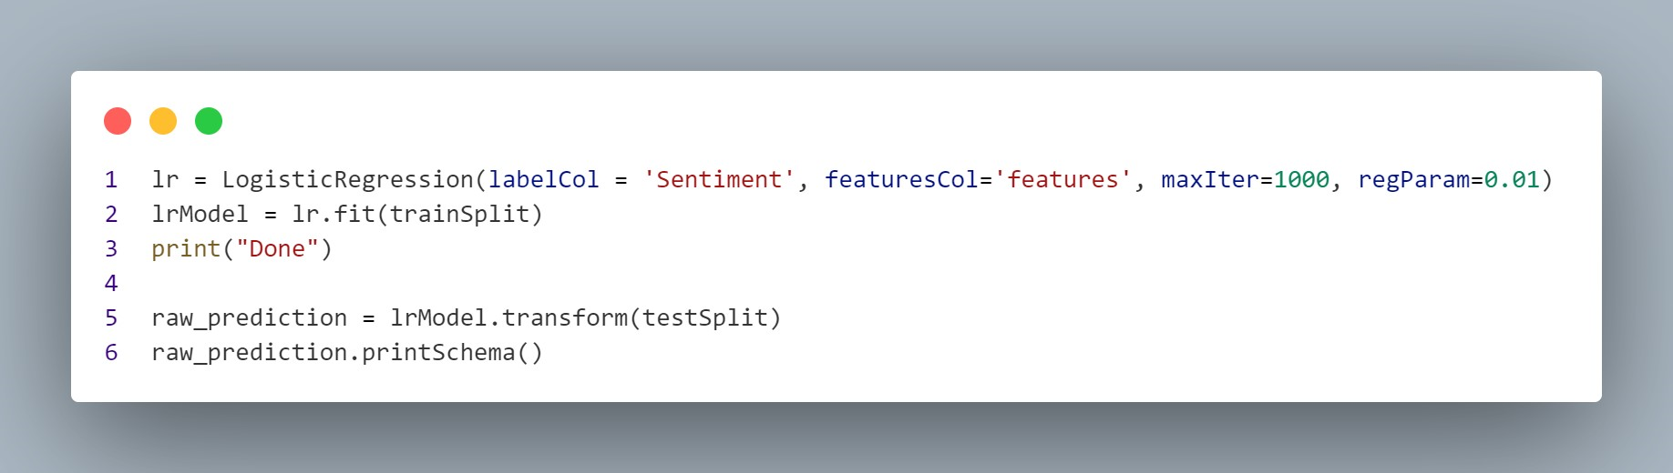
Applying the model on the test data
Number of correct predictions: 13879
Accuracy: 69.26685631581574

Slide 26
Discussion
In this project, we aimed to find relationships between words used in 100,000 tweets. The used algorithms Word2Vec, Dimension Reduction, k-means clustering, A-priori and Logistic Regression were able to find different kinds of relationships between words
Even with the reduced dimensions, the words in the graph still had a distinguishable similarity between them
We also found out which words are most likely to be used in positive and negative tweets
However the ambiguity of some words our results still present conflicting findings
For instance, it seems contradictory that the word ”good” is one of the most frequently used words in negative tweets as well: in future studies, we believe that implementing more advanced preprocessing techniques could yield improved results, not only in classification but also in generating more intuitive visualizations on the graph

